Slide 1
FEELINGS
UU Westport March 9, 2026
Rev. Carlton Smith
Denise Carreau Steven Rosenberg
Co-Facilitators

Slide 2
Emotions vs. Feelings
Emotions are intense, automatic, and universal physiological responses to stimuli (like a racing heart from fear), occurring in the body and brain's subconscious.
Feelings are the subjective, conscious, and personal interpretation of these emotions, influenced by memories and beliefs.
Emotions are temporary and physical, while feelings last longer and are mental.

Slide 3
Emotions vs. Feelings Example
Emotion: A sudden, racing heart (physical sensation) when hearing a loud noise.
Feeling: The conscious interpretation of that fear as "I am terrified." or "I am excited" based on context.

Slide 4
What Causes us to feel in a selected way?
What others say and do may be the stimulus of our feelings, but not the cause.
While events/people can influence your mood, you ultimately choose your reactions by controlling your thoughts and behaviors.
We are responsible for what we do to generate our feelings.

Slide 5
The Mailbox Analogy
A person may hand you a letter (an action), but it’s up to you whether you decide to open it, read its contents, and allow it to affect your mood.

Slide 6
Identifying and Expressing Feelings
Sharing our feelings encourages compassion.
Allowing ourselves to be vulnerable by expressing our feelings can help to resolve conflicts.

Slide 7
WHY IS IT DIFFICULT FOR SOME PEOPLE TO EXPRESS THEIR FEELINGS?
Thoughts were considered important.
Feelings were not considered important.

Slide 8
WHY IS IT DIFFICULT FOR SOME PEOPLE TO EXPRESS THEIR FEELINGS?
They were taught to suppress them;
feelings are weakness.
2. They fear vulnerability;
expressing feelings reveals our inner world.
3. Limited vocabulary;
Many people know a limited number of feeling
words.
4. They confuse thoughts and feelings;
they hide their true emotions.

Slide 9
Steps
Name the Feeling: Identify whether you are truly sad, angry, or simply tired.
Examine the Thought: Ask, "What am I telling myself about this situation?”
Pause and Reflect: Step back from the situation to avoid immediate, reactive emotions.
Needs: Ask, “Are my need(s) being met?”
“Which need(s) are being/not being met?

Slide 10
Label Your Feelings
Once you are aware of your feelings, try to name them.
This will help you to understand what you are feeling and why.

Slide 11
Build a Vocabulary of Words that Name Feelings
It helps to use words that refer to specific emotions.
”I feel good about that?”
happy?
excited?
relieved?

Slide 12
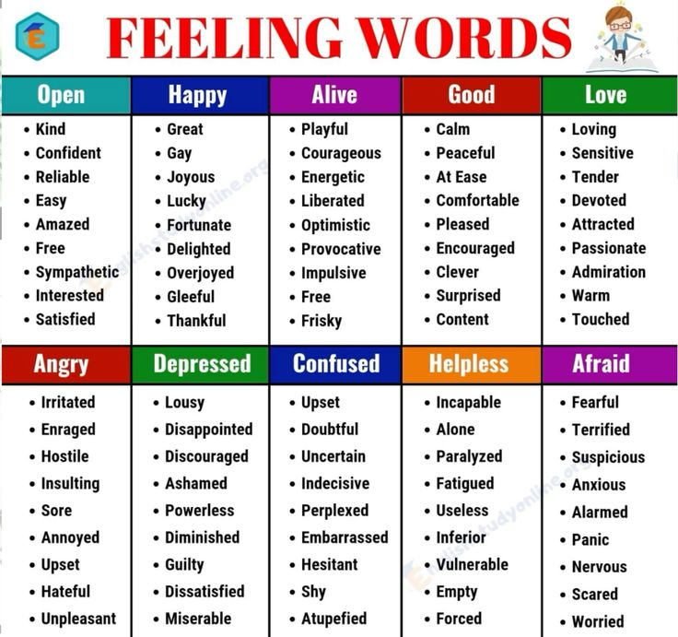

Slide 13


Met Needs/Unmet Needs
There are no positive or negative emotions, just emotions we feel when our needs are met and emotions we feel when our needs are not met.

Slide 14
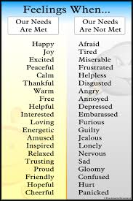

Slide 15
Build a Vocab Words that Name Feelings
How to Express Feelings
1. Start with “I feel…” (avoid “I feel like/that/as if.”)
2. Name one clear feeling; be specific (i.e. “uneasy” is better than “bad’)
3. Avoid blaming language. “I feel angry because YOU…”
(The feeling arose from your need and not another person.)
4. Connect feeling to a need. “I feel lonely because I need connection.”

Slide 16
How to Express Feelings
Linking our feelings to our needs makes it more likely that we will connect to each other.
“I was confused when you told me that you didn’t want to work with me.”
“When you told me that you didn’t want to work with me, I was confused because I needed your cooperation.”

Slide 17
Faux Feelings
Are These Feelings?

Slide 18
Words that describe what we think others are doing to us.
To support connection, it’s helpful to differentiate between feelings and words that describe what we think others are doing to us.

Slide 19
Words that describe what we think others are doing to us.
For example, “I feel misunderstood,” is an assessment of the other person’s level of understanding whereas “I feel discouraged because I’m wanting understanding” expresses what’s going on with us.

Slide 20
Words that express how we interpret others are not feeling words (examples).
I felt betrayed when you began dating other people.
Vs.
When you began dating other people, I was devastated because I thought we had agreed to be in a committed relationship.

Slide 21
Words that describe what we think others are doing to us.
I felt you ignored me.
When you ignored me at the office, I felt relieved because I hoped to finish my work and leave early.
or
When you ignored me at the office, I was upset because I was hoping we could talk out our differences.

Slide 22
Words that express more how we are interpreting others than how we are feeling:
abandoned ignored put-down
abused intimidated rejected
betrayed let-down threatened
boxed-in manipulated unappreciated
bullied misunderstood unheard
cheated neglected unseen
coerced overworked used
cornered patronized unwanted
distrusted pressured

