Slide 1
Non -Violent Communication
Compassionate Communication
UU Westport March, 2026
Rev Carlton Smith
Denise Carreau Steven Rosenberg
Co-Facilitators

Slide 2
Compassion by Miller Williams
Have compassion for everyone you meet,
even if they don't want it. What seems conceit,
bad manners, or cynicism is always a sign
of things no ears have heard, no eyes have seen.
You do not know what wars are going on
down there where the spirit meets the bone.

Slide 3

Non -Violent Communication
Compassionate Communication
Marshall B. Rosenberg, Ph.D.

Slide 4

What is NVC ?
NVC is a way of communicating that is meant to keep people compassionately connected.
NVC is a way of making us consciously aware of the need to think, speak and act with compassion.

Slide 5
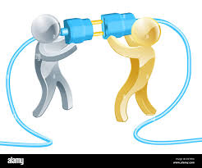
What Is Your Intention?
The intention of your communication is to improve your connection with others for the purpose of bringing joy to all.
The intention of your communication
Is to increase the possibility that everyone’s needs are met.
The intention of your communication is to foster compassion for others and yourself.

Slide 6
Components of NVC
O F R T
1. Observations
2. Feelings
3. Needs
4. Requests

Slide 7

1. Observations
Things we see as definitely true – as if we are observing the scenario on a video recording.
Grounding communication in concrete facts helps to establish a shared reality.
This subtle shift opens space for productive conversation that can lead to meeting the needs of all.

Slide 8
Observations vs. Evaluations
Some of us immediately judge others when we are observing.
By not making judgements, we show compassion.
Instead of automatically judging what we are observing we need to think in terms of everybody’s needs.
When we conflate opinions with observations, it is less likely that others will hear our intended meaning.

Slide 9
Observations vs. Evaluations
Many people will get defensive when hearing a judgement.
1. You're always late.
2. You never listen.
3. Your so lazy.
4. You don't care about
me.
1. You arrived 15 min after our agreed time.
2. You looked at your phone while I was talking.
3. You didn't complete three tasks this week.
4. I noticed you didn’t
ask about my day.

Slide 10

2. Feelings
How did you feel when making the observation?
Expressing how you feel increases the possibility of compassion.
What you observe is a stimulus and not a cause of how it made you feel.
You are fully responsible for the way you feel.
Two people can observe the same event, and each one has a different emotional reaction as a result.

Slide 11
When we express our feelings, we allow ourselves to be vulnerable in a way that fosters connection,
Feelings are internal emotional states — not thoughts, judgments, or stories about what others are doing.
Sharing authentic feelings invites compassion. It shifts conversation from debate to understanding.
Sharing authentic feelings invites compassion. It shifts conversation from debate to understanding.

Slide 12
2. Feelings;
How do your observations make you feel?
You are responsible for your feelings.
Negative feelings indicate that your needs are not being met.
Positive feelings indicate that your needs are being met.

Slide 13
Feelings when your needs are Feelings when your needs are being met (examples) are not being met (examples)
excited
engaged
grateful
hopeful
inspired
angry
annoyed
aversion
afraid
yearning

Slide 14
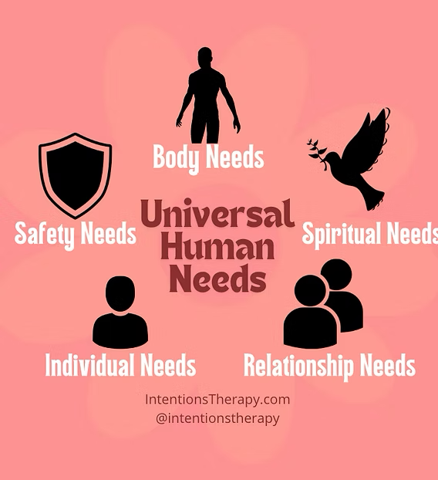
3. Needs
All humans in all cultures have the same needs

Slide 15

3. Needs
By expressing our needs clearly, we increase the likelihood that people will fulfill them because it is in our nature to give and receive in a compassionate manner.

Slide 16
What is the underlying need?
“You never listen to me.”
In this example, perhaps the speaker was seeking validation of his ideas.
“You looked at your phone several times while I was speaking. I get frustrated when I think my words aren’t being heard because I need to have my ideas considered even if they are not adopted.”
When both people articulate their needs clearly and compassionately, mutual understanding can be achieved.

Slide 17
4.Requests
“Would you be willing to put down your phone while I talk?”
Requests invite collaboration rather than demand compliance:
This request respects both parties’ autonomy and encourages cooperation based on shared values rather than coercion.

Slide 18
4. Requests; Inviting cooperation
Positive: state what you want (not what you don’t).
Specific: use concrete, actionable language. Vague requests leave the other person guessing.
Negotiable: A request leaves room for “no.”
If refusal leads to punishment, it’s a demand.

Slide 19
The NVC Formula
“When I observe, I feel, because I need. Would you be willing to?”
“You never clean up the sink after dinner.”
How to say this in NVC?
Include observation, feeling, need, request.

Slide 20
The NVC Formula
“When I observe, I feel, because I need. Would you be willing to?”
“When I observe, I feel, because I need. Would you be willing to?”
“When I observe, I feel, because I need.
“When I see the dishes in the sink over an hour after we clear the table, I feel frustrated because I need cooperation in our home. Would you be willing to load the dishwasher within one hour after we put them in the sink?”

Slide 21

Transform This Statement :
Observation + Feeling + Need + Request
“You’re being selfish-you only think about yourself.”

Slide 22
Transform This Statement :
Observation + Feeling + Need + Request
“You’re being selfish-you only think about yourself.”
“I am disappointed that you bought a suit with money we were saving to get furniture. I need to know that I can trust you to use our money in the way we planned. What’s going on?”

Slide 23
O F N R
1. Observing: State what your senses recorded without judgements or opinions.
2. Identifying and expressing Your feelings
3. Identifying your needs
4. Requesting cooperation

